Slide 1

2023 Women's World Cup A Tactical Analysis of Individual Risks on Team Performance
Christopher Spann
1/31/2024

Slide 2
Overview
This analysis seeks to identify if risks taken by individuals on the pitch correlate with team success throughout the World Cup.
Dribbles
Interceptions
Data comes from StatsBomb github for open data
Competition: 2023 Women’s World Cup
Matches: Group stage match data
Events: Dribbles and Interceptions event types

Slide 3
Dribbles
StatsBomb defines a dribble as an attempt by a player to beat an opponent
1,626 total attempted dribbles in the 48 group stage matches
Dribble Outcome | Definition | Classification
Complete | Dribble attempt was successful | Success
Incomplete | Player was unable to complete the act of attempting a dribble | Failure

Slide 4
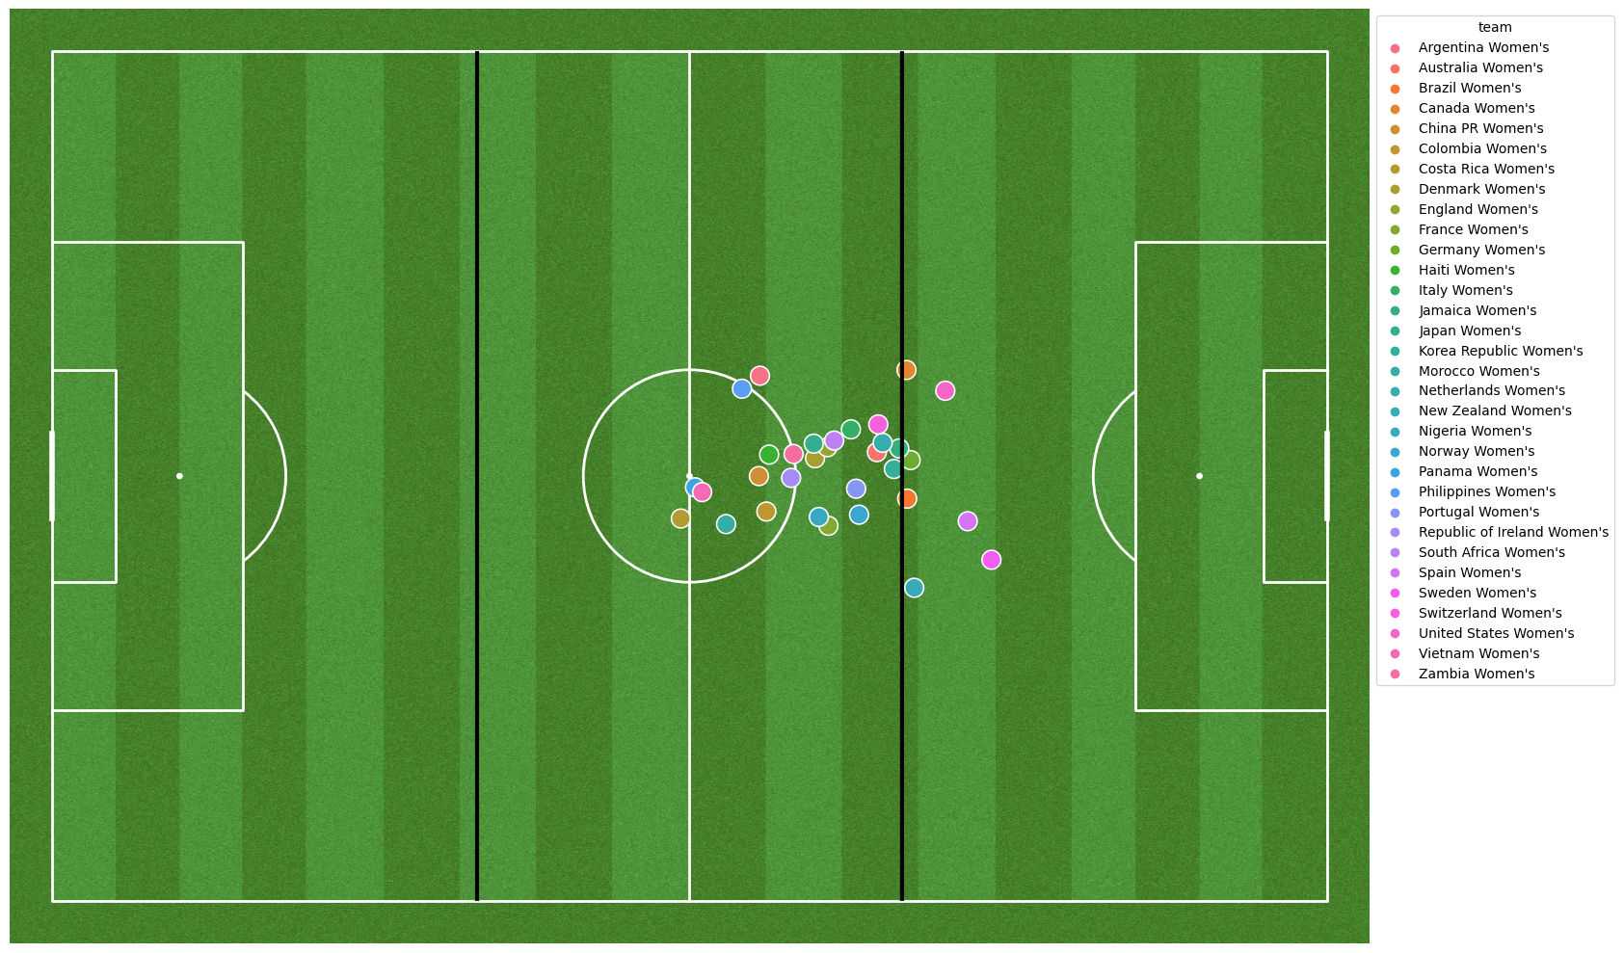
Average Location for Attempted Dribbles by Team for the Group Stage

Slide 5
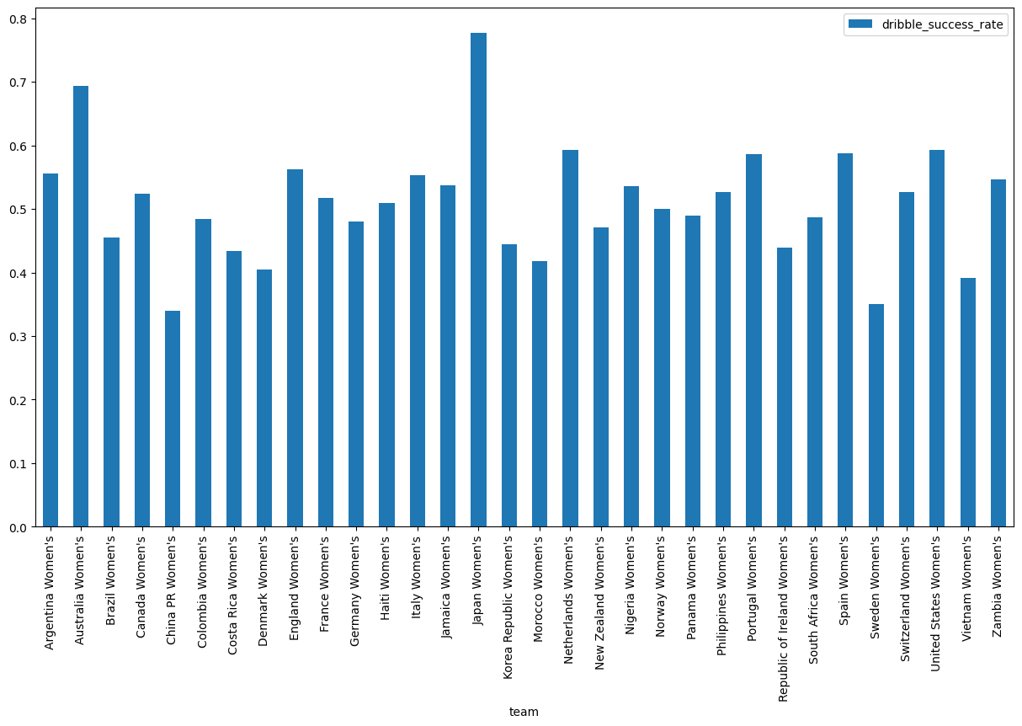
Japan had the highest dribble success rate during the group stage
28 completed in 36 attempts
77.78% Success Rate
Japan had a goal differential of +11 during the group stage with 11 goals scored in their 3 matches
Advanced the QF of the WC
China had the lowest dribble success rate during the group stage
16 completed in 47 attempts
34.04% Success Rate
China had a goal differential of -5 during the group stage with only 2 goals scored in their 3 matches
Failed to advance past group play

Slide 6
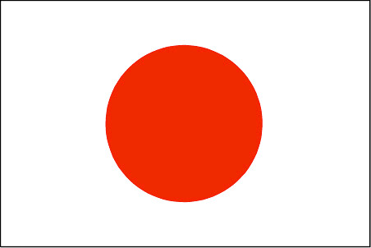
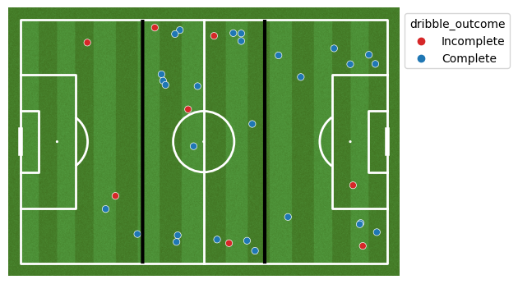
Defending Neutral Attacking
The image on the right shows a map of attempted dribbles by team Japan during the group stage
Attacking Third
Attempted: 12
Completed: 10
Rate: 83.33%
Neutral Third
Attempted: 20
Completed: 16
Rate: 80.00%
Defending Third
Attempted: 4
Completed: 2
Rate: 50.00%
Japan had an average dribble position of (71.69, 36.95)

Slide 7

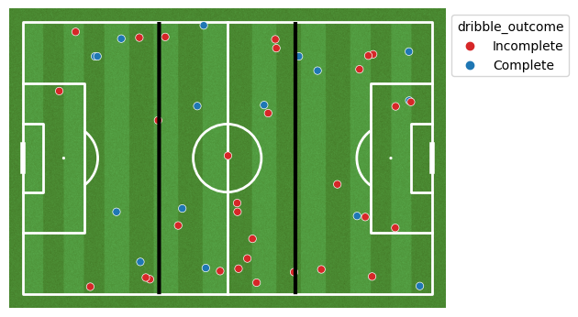
Defending Neutral Attacking
The image on the right shows a map of attempted dribbles by team China during the group stage
Attacking Third
Attempted: 16
Completed: 6
Rate: 37.50 %
Neutral Third
Attempted: 19
Completed: 5
Rate: 26.32 %
Defending Third
Attempted: 12
Completed: 5
Rate: 41.67 %
China had an average dribble position of (66.53, 40.01)

Slide 8
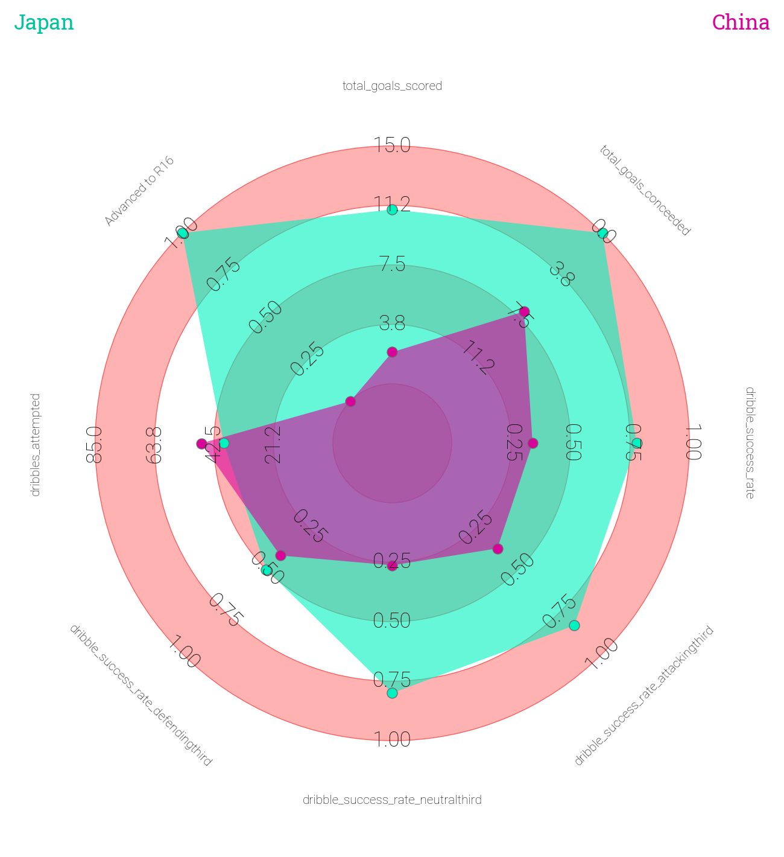
China may have attempted more dribbles, but Japan was more clinical in successfully executing them
A major difference between the two teams comes in the neutral third of the field
Tactically, Japan was more selective in taking risks with attempted dribbles further up the field, but that led to greater success rates
Corresponded with more goals and a better goal differential
Success could be a result of risk analysis – players having good judgement for when taking on a player is likely to benefit the team

Slide 9
Team Distinction | Avg Goals For | Avg Goals Against | # of teams to R16 | # of teams to QF | # of teams to SF | # of teams to Final
Avg X location for dribble attempts above mean | 4.64 | 1.93 | 8 | 4 | 3 | 1
Avg X location for dribble attempts below mean | 3.39 | 5.50 | 8 | 4 | 1 | 1
Teams that had an average dribble attempt location above the mean for all teams scored more goals and gave up fewer goals, on average
There was not a strong distinction for likelihood of advancement to further rounds based on the average dribble attempt location

Slide 10
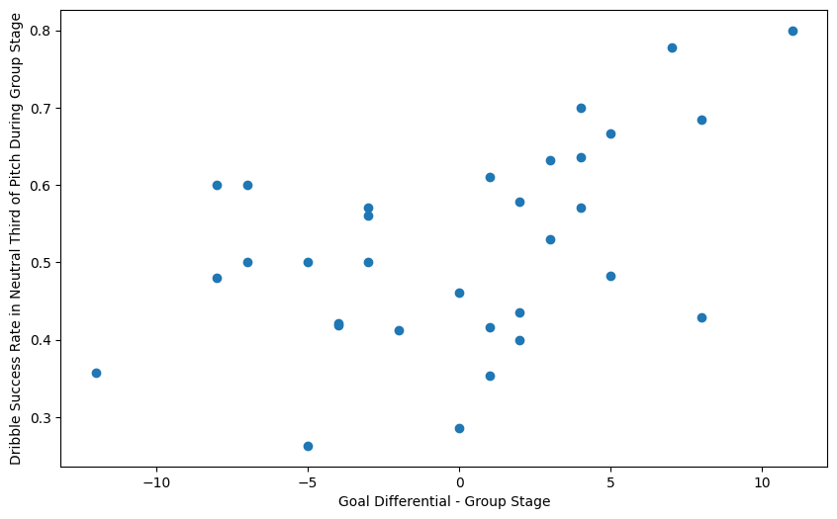
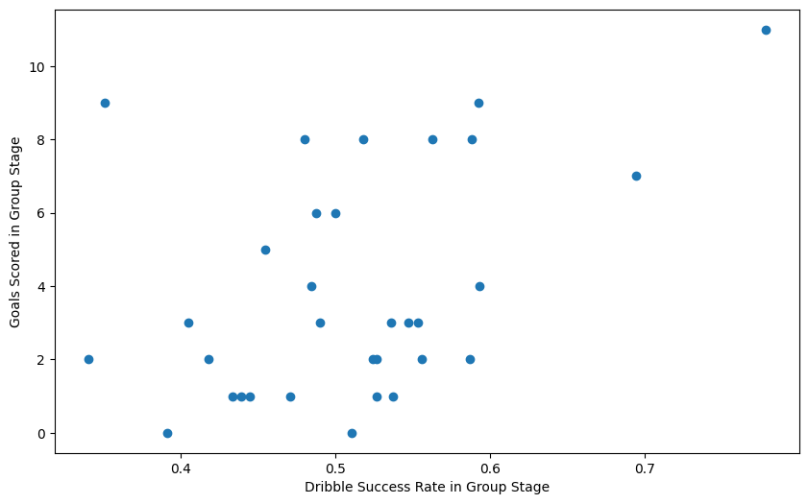
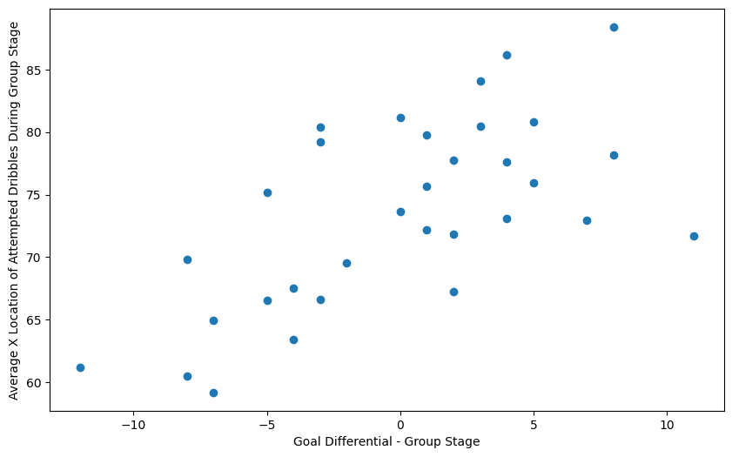
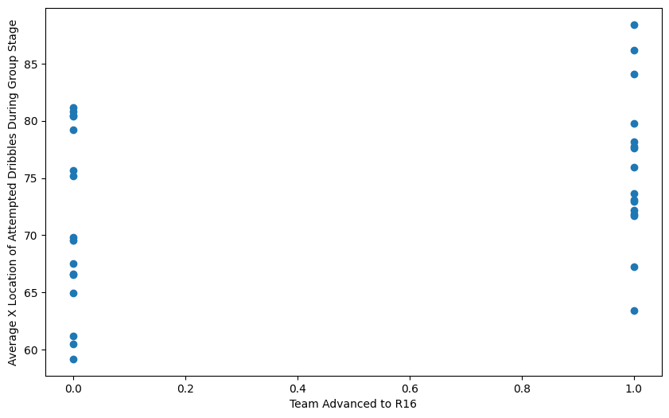
Statistical Analysis
r = 0.48
r = 0.43
A moderately high correlation exists between goal differential in the group stage and the average x location of dribbles attempted during the group stage
Teams that had a higher dribble success rate were more likely to make it past the group stage (to R16)
Good decision-making with dribbles in the neutral third often led to better goal differential for teams in the group stage
r = 0.65
r = 0.32

Slide 11
Interceptions
StatsBomb defines an interception as the act of preventing an opponent’s pass from reaching their teammates by moving to the passing lane/reacting to intercept the ball
1,013 total attempted interceptions in the 48 group stage matches
Interception Outcome | Definition | Classification
Won | attempt that ended up in possession of the tackler | Success
Success In Play | attempt that knocked the ball to a teammate | Success
Success Out | attempt that knocked the ball out of play in favor of the tackling team | Success
Lost In Play | interception attempt that knocked the ball to an opponent | Failure
Lost Out | interception attempt that knocked the ball out of play in favor of the opposition | Failure

Slide 12
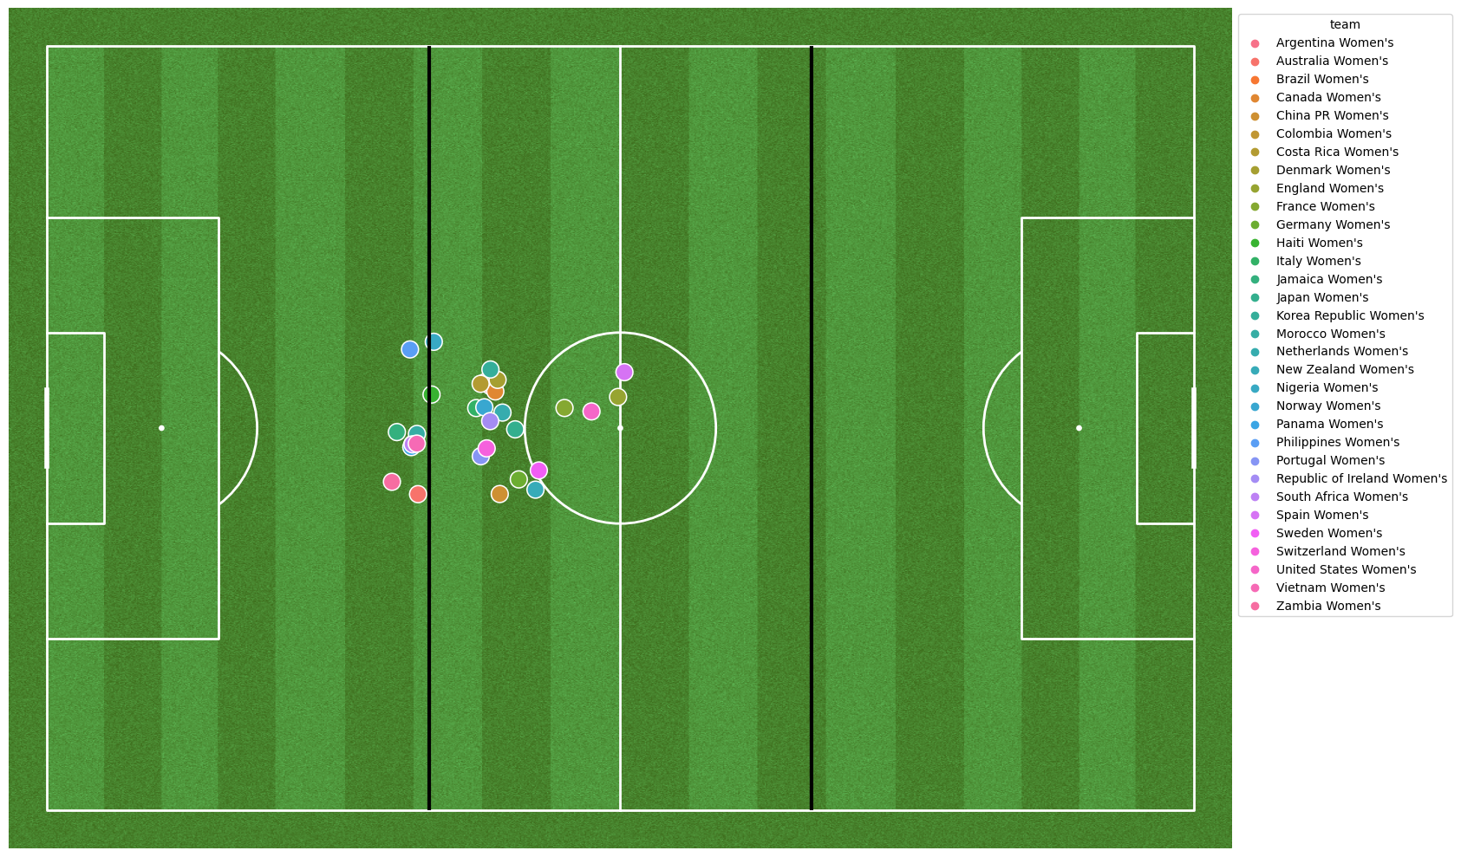
Average Location for Attempted Interceptions by Team for the Group Stage

Slide 13
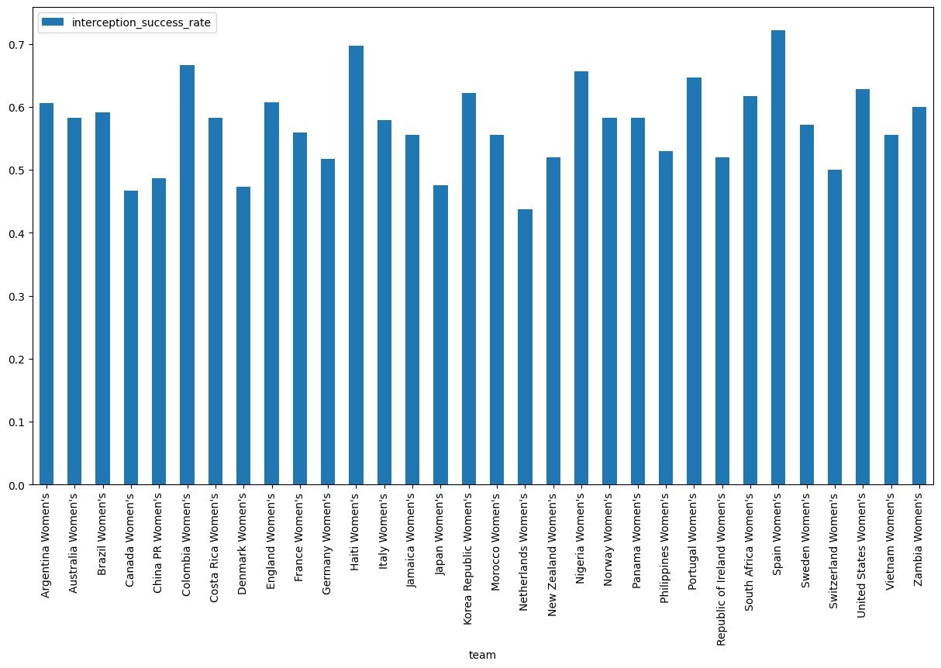
Spain had the highest interception success rate during the group stage
13 completed in 18 attempts
72.22% Success Rate
Spain had a goal differential of +4 during the group stage with 8 goals scored in their 3 matches
Advanced the Final of the WC and won
Netherlands had the lowest interception success rate during the group stage
14 completed in 32 attempts
43.75% Success Rate
Netherlands had a goal differential of +8 during the group stage with 9 goals scored in their 3 matches
Advanced to QF of the WC
* Unlike dribble success rate, interception success rate does not appear to influence team performance

Slide 14

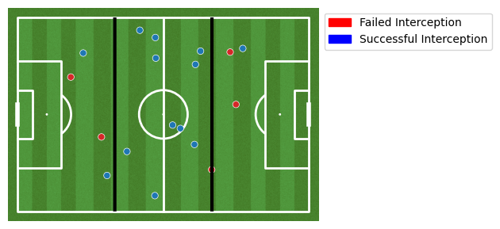
The image on the right shows a map of attempted interceptions by team Spain during the group stage
Attacking Third
Attempted: 3
Completed: 1
Rate: 33.33%
Neutral Third
Attempted: 11
Completed: 10
Rate: 90.91%
Defending Third
Attempted: 4
Completed: 2
Rate: 50.00%
Defending Neutral Attacking
Spain had an average interception position of (60.43, 34.15)

Slide 15

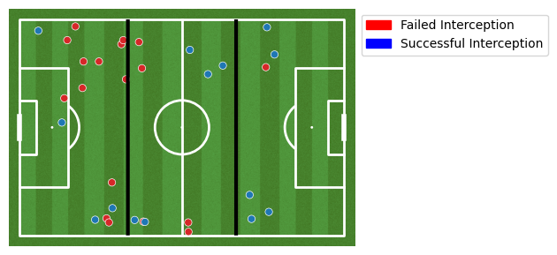
The image on the right shows a map of attempted interceptions by team Netherlands during the group stage
Attacking Third
Attempted: 6
Completed: 5
Rate: 83.33%
Neutral Third
Attempted: 10
Completed: 5
Rate: 50.00%
Defending Third
Attempted: 16
Completed: 4
Rate: 25.00%
Defending Neutral Attacking
Netherlands had an average interception position of (47.67, 38.38)

Slide 16
Interception success rate does not correlate with team success like dribble success rate does, but the average location of attempted interceptions made a clear separation between teams that performed well and teams that did not
Team Distinction | Avg Goals For | Avg Goals Against | # of teams to R16 | # of teams to QF | # of teams to SF | # of teams to Final
Avg X location for interception attempts above mean | 5.00 | 2.44 | 10 | 6 | 3 | 2
Avg X location for interception attempts below mean | 2.57 | 5.86 | 6 | 2 | 1 | 0
Teams that had an average interception attempt location above the mean for all teams scored more goals and gave up fewer goals, on average
Teams that had an average interception attempt location above the mean for all teams were more likely to advance further in the tournament

Slide 17
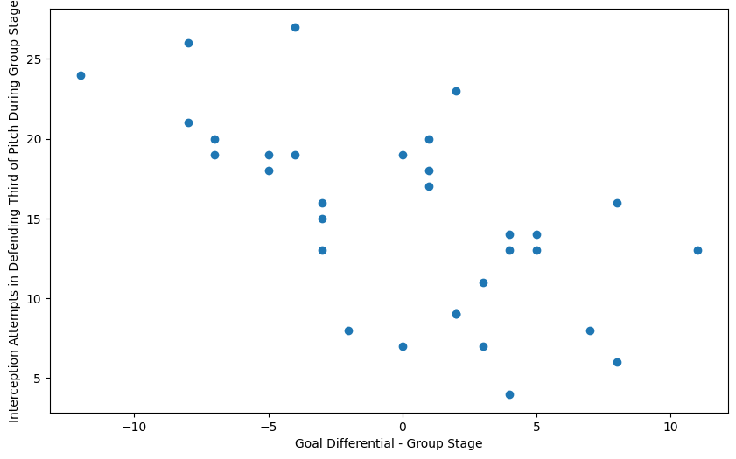
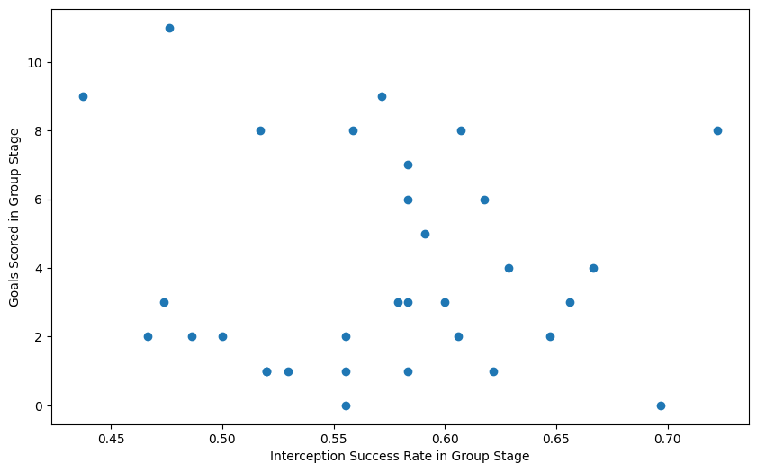
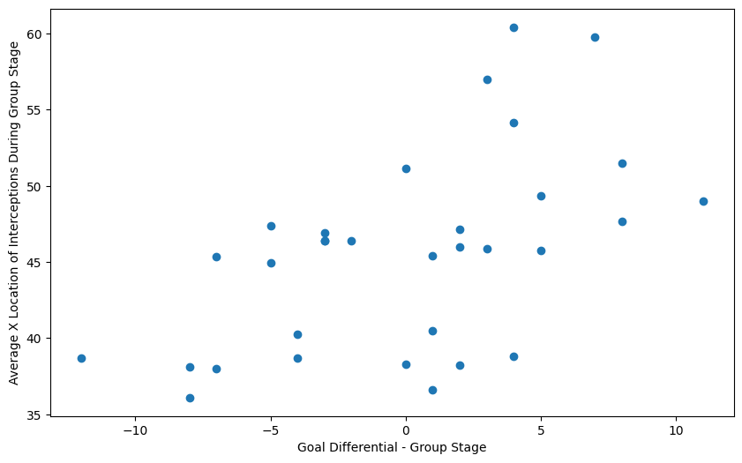
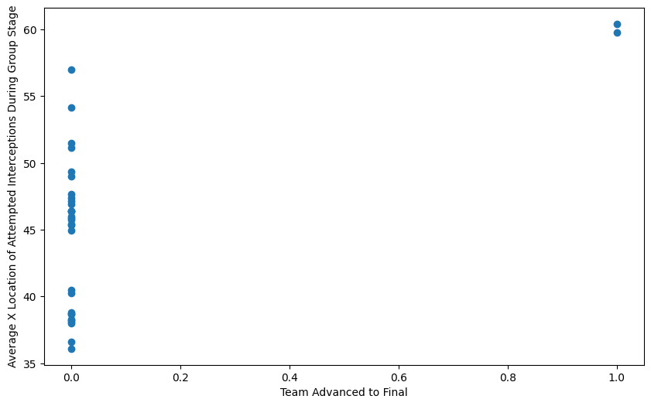
Statistical Analysis
A moderately high correlation exists between goal differential in the group stage and the average x location of interceptions attempted during the group stage
Teams that had a higher interception success rate were more likely to make it past the group stage (to R16), and a high correlation existed for making it to the final
Strong negative correlation between interception attempts in defending third of pitch and goal differential
No correlation between interception success rate and goals scored or goal differential
r = -0.62
r = -0.08
r = 0.55
r = 0.59

Slide 18
Summary of Insights
This analysis sought to identify if dribbles and interception statistics had a strong correlation with team success in the 2023 Women’s World Cup
Evidence suggests that dribble success rate, average location of dribble attempts, and average location of interception attempts are most strongly correlated with goal differential
The average location of interception attempts was the most significant indicator for which teams were likely to advance in the tournament

Slide 19
Application to Other Events/Leagues
Adjust Defensive Tactics to Strategically Emphasize Interceptions Higher on the Pitch
Interception attempts higher up on the pitch are more likely to result in a higher goal differential and advancement to later rounds; therefore, pressing in the attacking and neutral thirds should be encouraged.
Interception success rate does not seem to correlate with success, so frequent interception attempts should be encouraged
This may involve instructing defenders to focus on intercepting the ball in specific zones to not only prevent goals but also contribute to offensive opportunities.
Consideration of Dribble Attempt Location and Optimization of Dribble Strategies
Teams should emphasize good decision-making for players attempting dribbles. Having a high dribble success rate, especially in the neutral third of the pitch, is correlated with a better goal differential.
Player Positioning and Training
Consider training sessions that specifically address interception techniques and dribble strategies in the identified key locations. This targeted training can enhance players' decision-making and execution during critical match situations.

